Slide 1
Tick4Tock

Slide 2
Quick
Recap

Slide 3
Scenario
Imagine this...

Slide 4
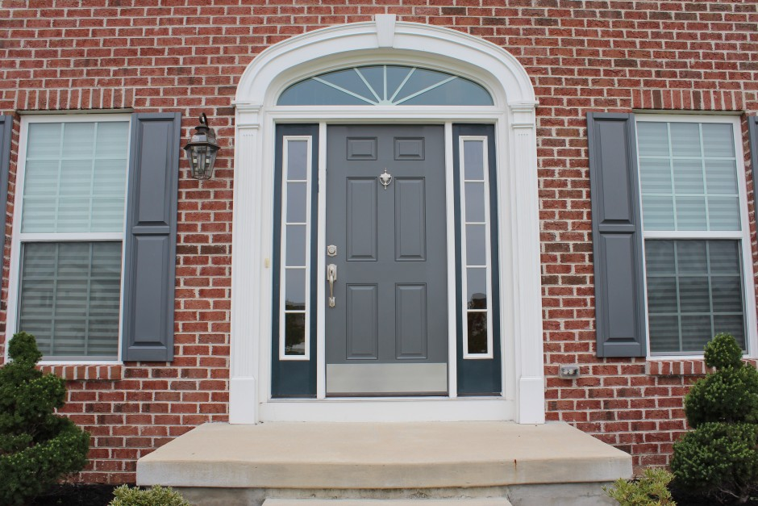
Notes:
You just came home from a long day at school, as you open the door...

Slide 5
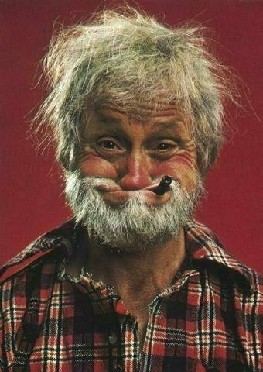
Notes:
Your crazy Uncle Dave runs out and yells “Good luck boy!”

Slide 6
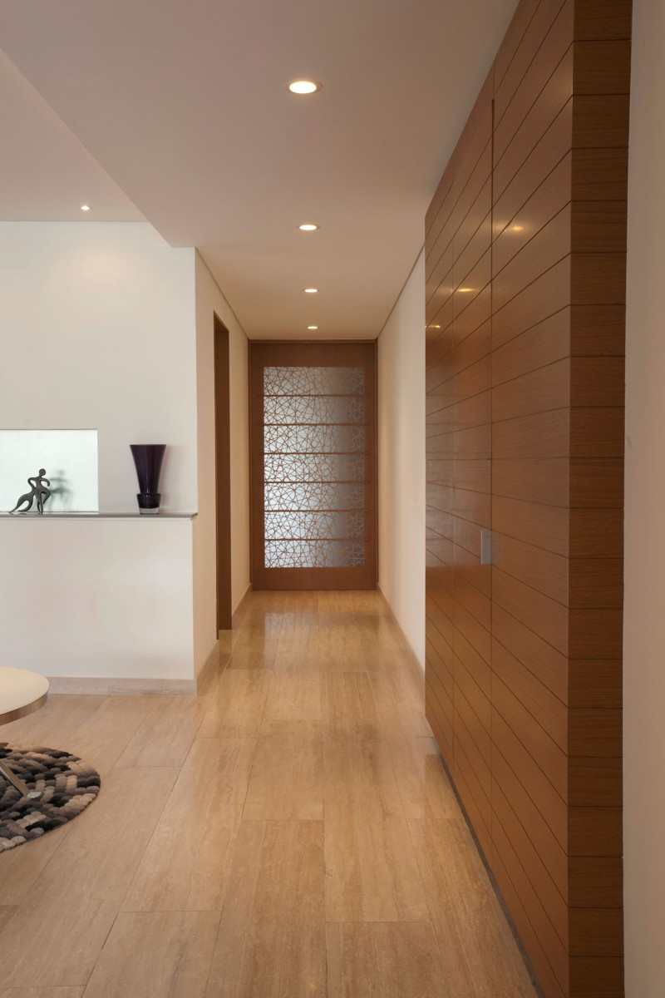
Notes:
Confused, you walk into the house, a stench engulfs you. You decide to follow the trail of the stench

Slide 7
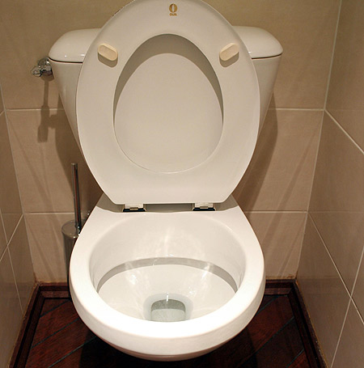
Censored
Notes:
You walk into the toilet, to realise that Uncle Dave let out a nuclear bomb. Your worst nightmare...

Slide 8
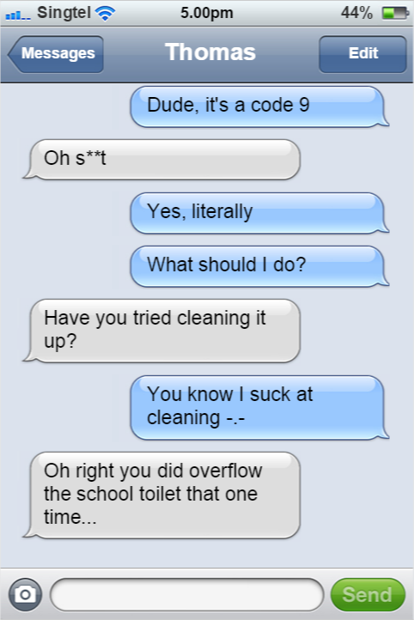
Notes:
You know full well you cannot clean anything. While at a loss, you decide to ask your friend Thomas for help <converse>

Slide 9
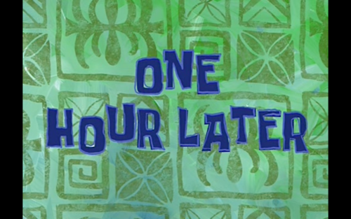

Slide 10
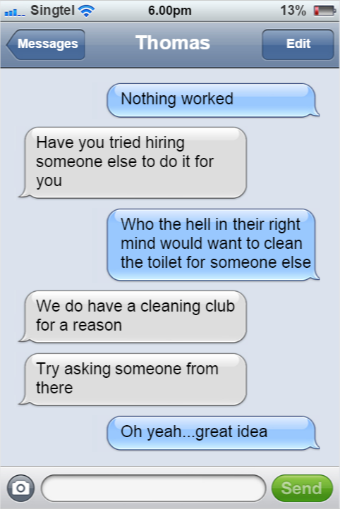

Slide 11
Another hour later...
Notes:
An hour later, you finally find someone from the cleaning club who is willing to help you

Slide 12
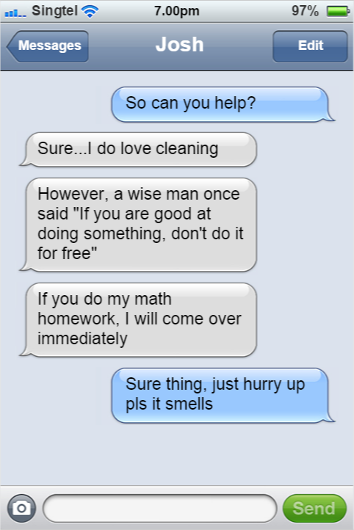
Notes:
After that, you gave him your address and he comes over and cleans your toilet while you do his math homework with ease.

Slide 13
Sure you solved your problem. But...
You took at least 2 hours just to have someone clean your s**t
You might not be so lucky as to have a Cleaning Club
You might not even be lucky enough to get someone like Josh who can help you
It there a way to simplify this process?

Slide 14
Introducing…
Tick4Tock
Smart name, eh?

Slide 15

Basic Idea
Trade in your time for someone else’s

Slide 16
Idea behind time trading
You need something done but don’t want to do it
You find someone to do it while you pay them
Win win!

Slide 17
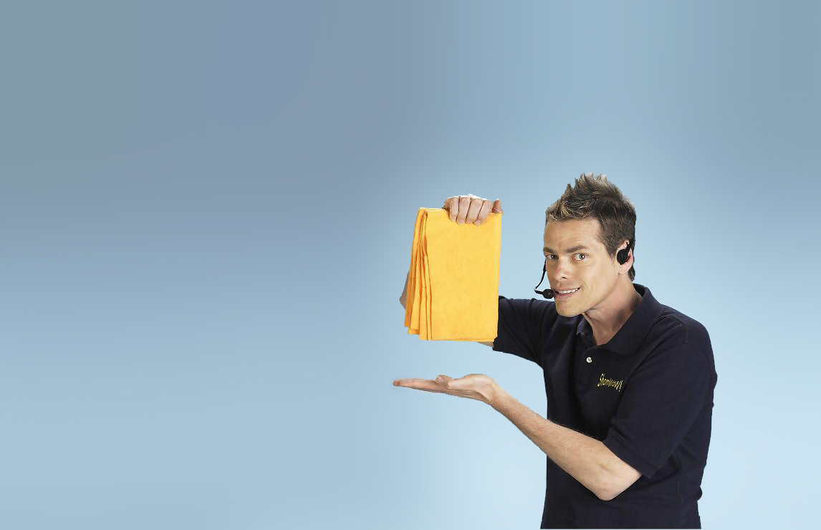
Demo

Slide 18
Differences between original idea and final product
A.K.A. which parts we failed to do

Slide 19
Differences
Original Idea
-Able to swap favors instead of just relying on time points
-Generally much better design
Final Product
-Relies solely on timepoints
-Bootstrap :/

Slide 20
Extensions
-Fix bugs
-All users are able to delete/edit/accept
-Ability to trade favor-for-favor
-Auto-deletes requests once done
-Alert user of upcoming requests
-Search for more than just tag
-Recommend requests to do based on past activities
-Generally quality of life improvements
-UI

Slide 21
Final Verdict
Functional but not the best

Slide 22
Market Competition
Also known as “Why we can’t have nice things”

Slide 23
Time trading is not a new idea
However, they are not well known

Slide 24
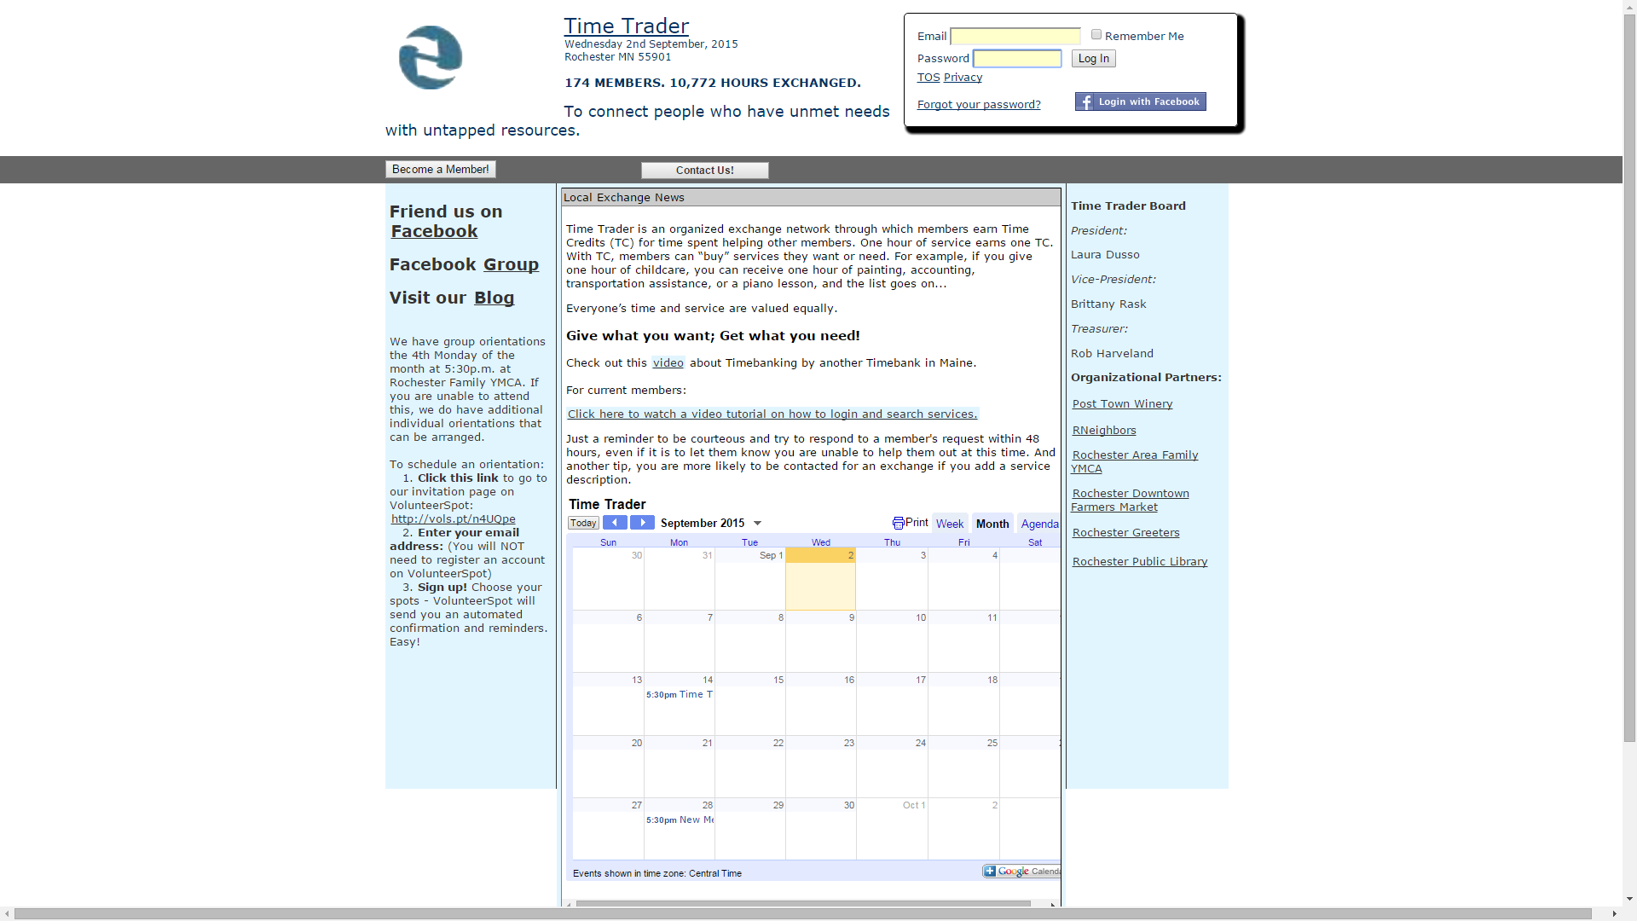
Time Trader

Slide 25
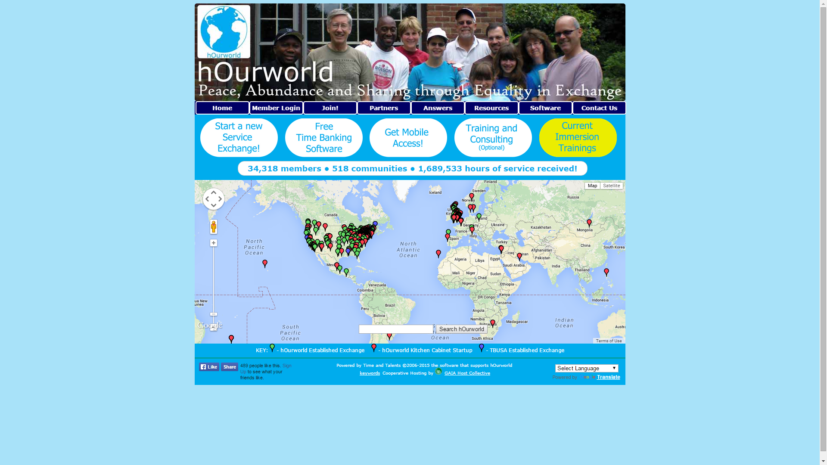
hOurworld

Slide 26
Key Differences
Time Trader
Uses Time Credit system
Limited to United States
hOurworld
Focused more on building communities of time traders as opposed to building a time bank itself
Spread across the world (although the only one in SEA is in Nababagay Giao)
Other Apps
Most use time credit system
Most have less users than the size of 1 RI class
Most are really outdated

Slide 27
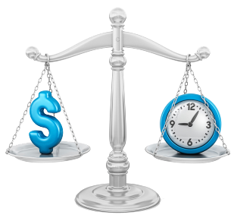
“Time is money.” -Benjamin Franklin

Slide 28
What do you want to do with your precious time?

Slide 29
Thanks!
Any questions?

Slide 30
Acknowledgements
Mrs Neo for helping us with errors
Alex Seow for teaching us ajax at 11pm
Pang Wen Yuen “Peanut” for fixing even worse errors
Arnold Tan for providing moral support for us late in the night
Anyone else who has helped us in any way

